Slide 1
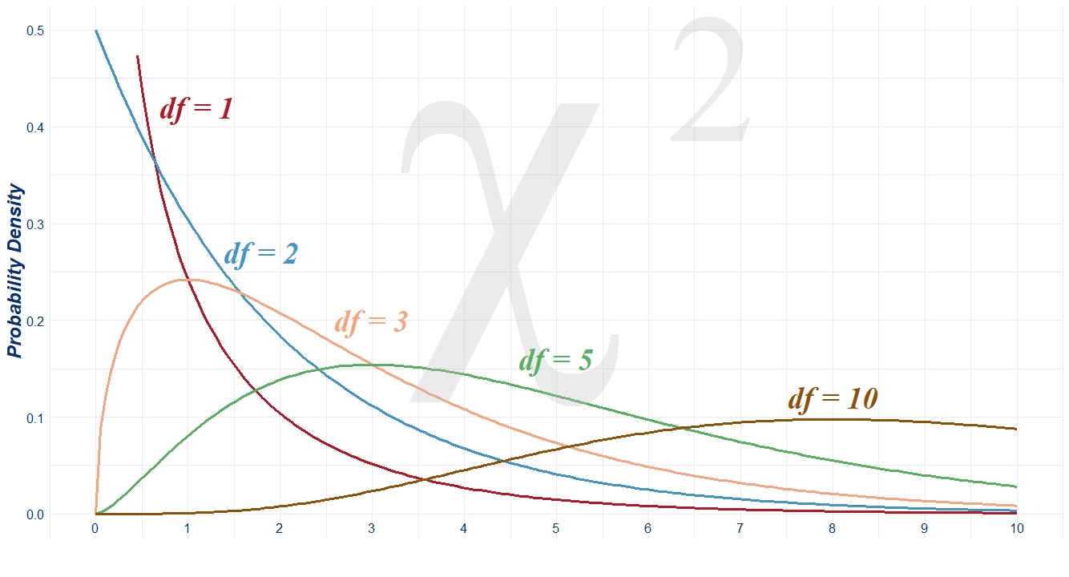

R Shiny App Platform for Education
Loan Robinson
April 5th, 2023

Slide 2
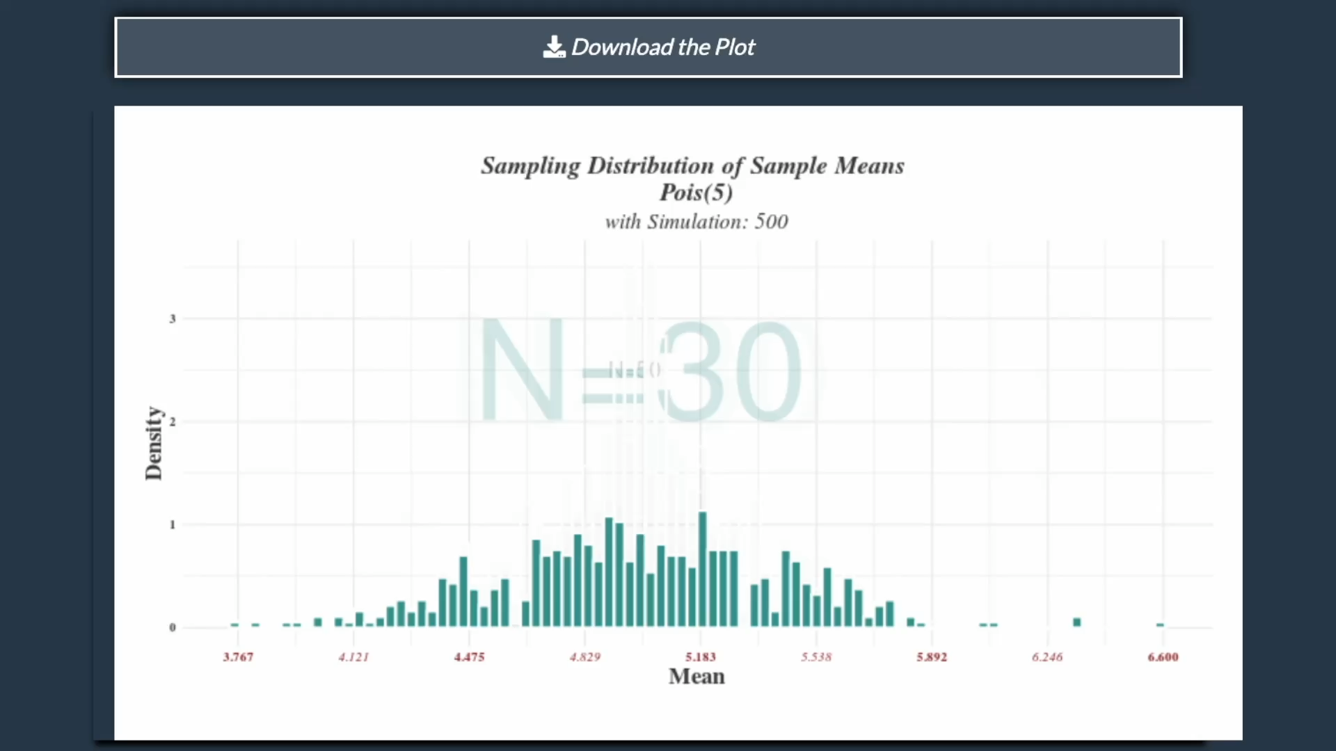
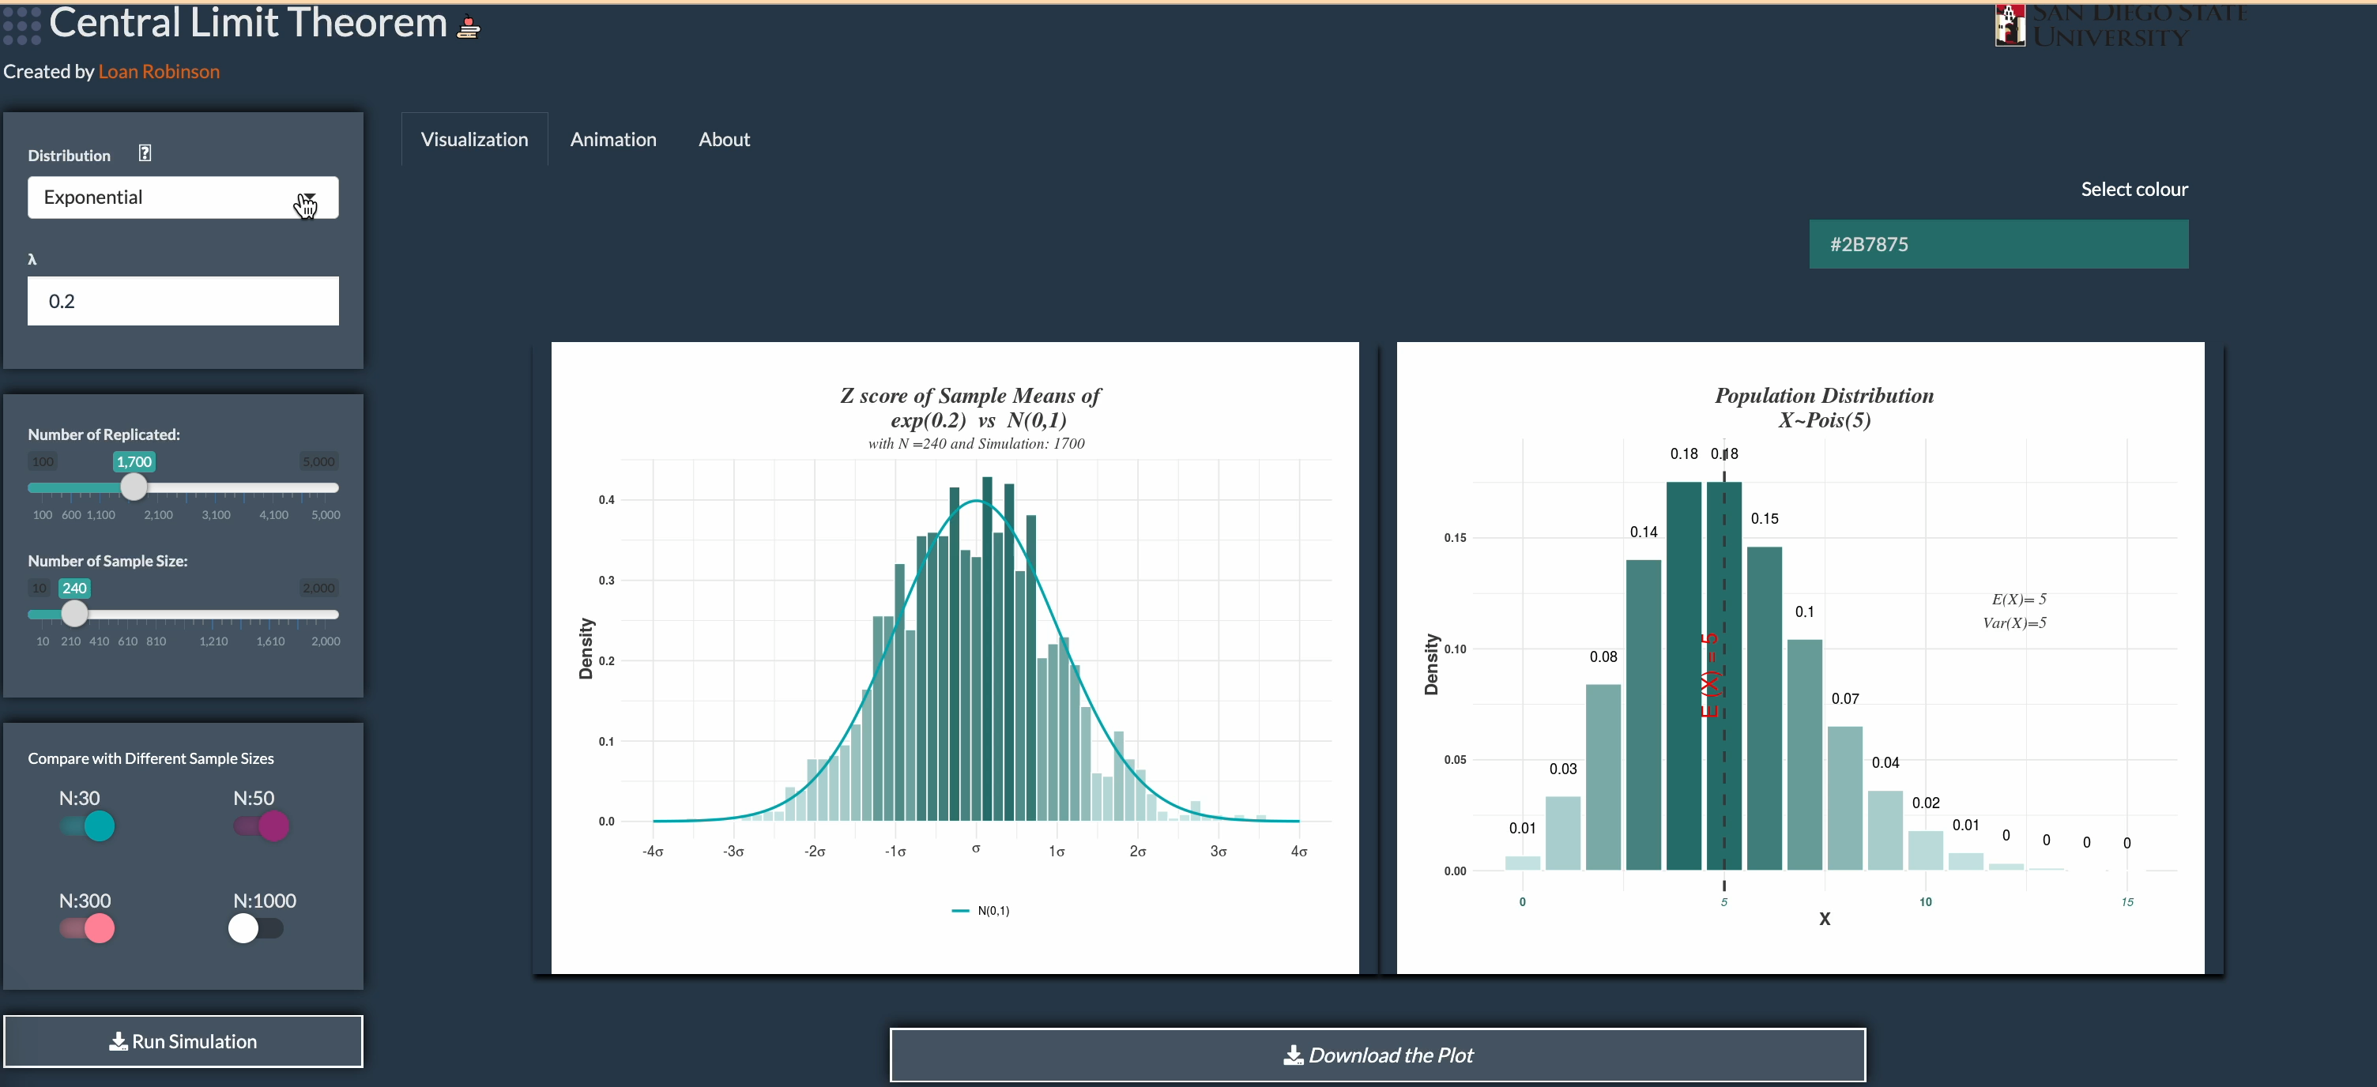
Interactive Visualization for Statistics lessons
Demonstrate the Central Limit Theorem
Visualize the differences between the number of sample sizes

Slide 3
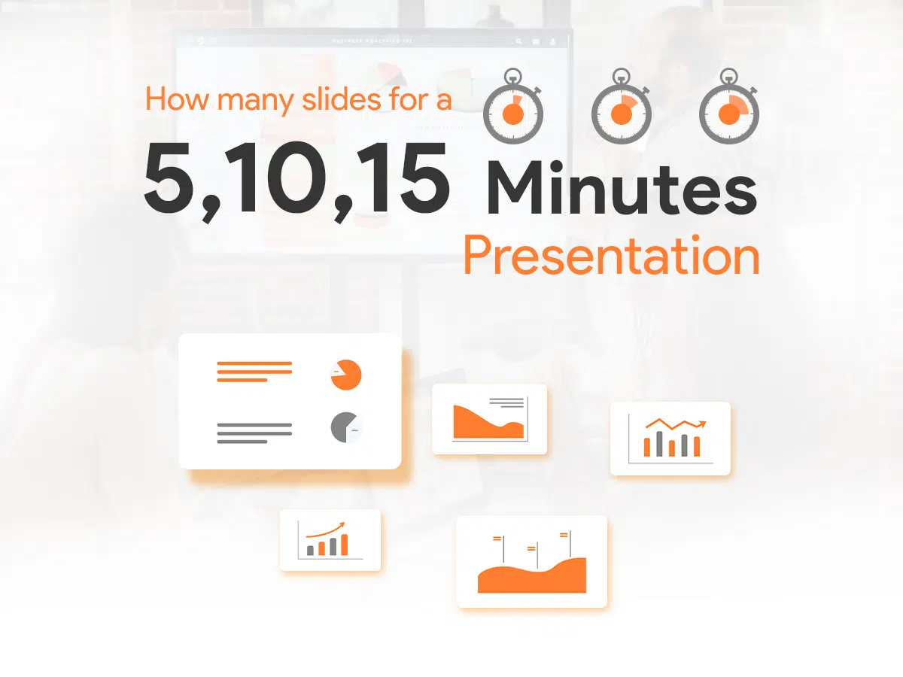
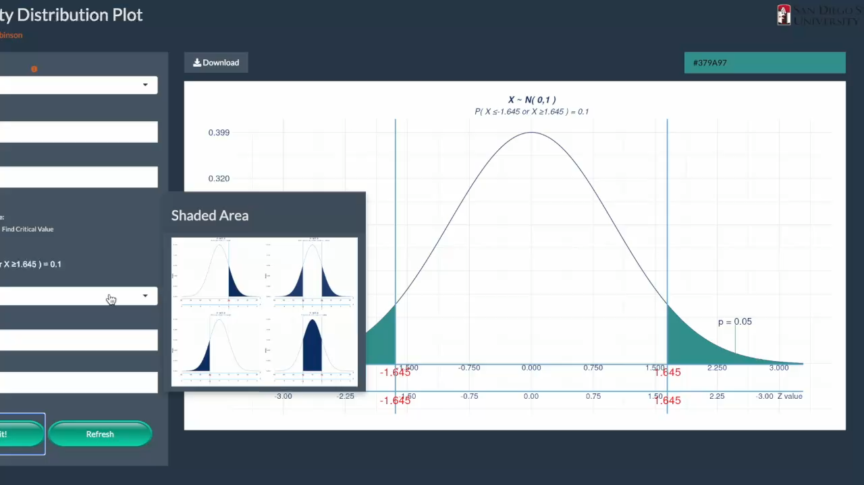
R Shiny App
PowerPoint
Everything in One Screen
Many slides for 1 topic

Slide 4
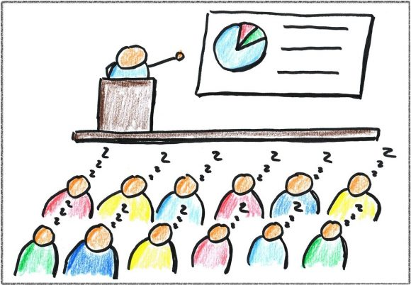

R Shiny App
PowerPoint

Slide 5
Continue ……………..

